Slide 1
Unit 4 I/O Generic,String Handling
ABDUR RAHIM S
821021104003

Slide 2
Generics in Java
Generics means parameterized types. The idea is to allow type (Integer, String, … etc., and user-defined types) to be a parameter to methods, classes, and interfaces. Using Generics, it is possible to create classes that work with different data types. An entity such as class, interface, or method that operates on a parameterized type is a generic entity.

Slide 3
Why Generics?
The Object is the superclass of all other classes, and Object reference can refer to any object. These features lack type safety. Generics add that type of safety feature. We will discuss that type of safety feature in later examples.
Generics in Java are similar to templates in C++. For example, classes like HashSet, ArrayList, HashMap, etc., use generics very well. There are some fundamental differences between the two approaches to generic types.

Slide 4
Types of Java Generics
Generic Method: Generic Java method takes a parameter and returns some value after performing a task. It is exactly like a normal function, however, a generic method has type parameters that are cited by actual type. This allows the generic method to be used in a more general way. The compiler takes care of the type of safety which enables programmers to code easily since they do not have to perform long, individual type castings.

Slide 5
Generic Classes:
A generic class is implemented exactly like a non-generic class. The only difference is that it contains a type parameter section. There can be more than one type of parameter, separated by a comma. The classes, which accept one or more parameters, ​are known as parameterized classes or parameterized types.

Slide 6
Generic Class
// To create an instance of generic
class BaseType <Type> obj = new BaseType <Type>()

Slide 7
Type Parameters in Java Generics
The type parameters naming conventions are important to learn generics thoroughly. The common type parameters are as follows:
T – Type
E – Element
K – Key
N – Number
V – Value

Slide 8
Advantages of Generics:
Programs that use Generics has got many benefits over non-generic code.
1. Code Reuse: We can write a method/class/interface once and use it for any type we want.
2. Type Safety: Generics make errors to appear compile time than at run time (It’s always better to know problems in your code at compile time rather than making your code fail at run time). Suppose you want to create an ArrayList that store name of students, and if by mistake the programmer adds an integer object instead of a string, the compiler allows it. But, when we retrieve this data from ArrayList, it causes problems at runtime.

Slide 9
Program:
class Main {
public static void main(String[] args) {
// initialize the class with Integer data
DemoClass demo = new DemoClass();
// generics method working with String
demo.<String>genericsMethod("Java Programming");
// generics method working with integer
demo.<Integer>genericsMethod(25);
}
}
class DemoClass {
// creae a generics method
public <T> void genericsMethod(T data) {
System.out.println("Generics Method:");
System.out.println("Data Passed: " + data);
}
}

Slide 10
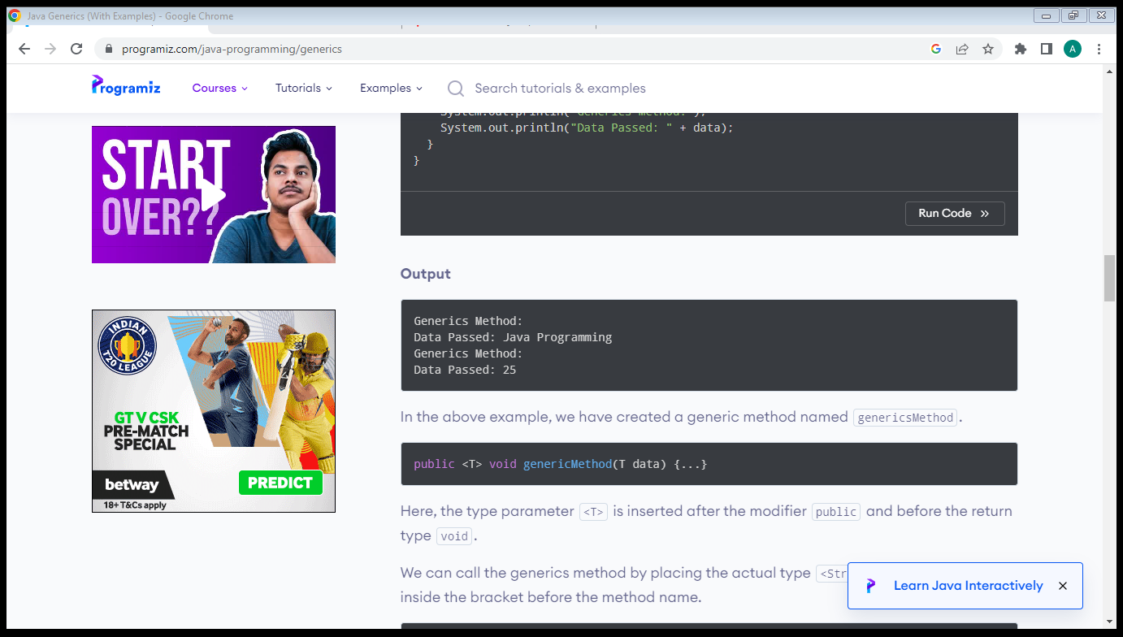
Output:

Slide 11
Thank you

